Slide 1
Intro to Coding with Python– Graphics
Dr. Ab Mosca (they/them)
Slides based off slides courtesy of Jordan Crouser (https://jcrouser.github.io/)

Slide 2
Plan for Today
Drawing pictures with graphics

Slide 3
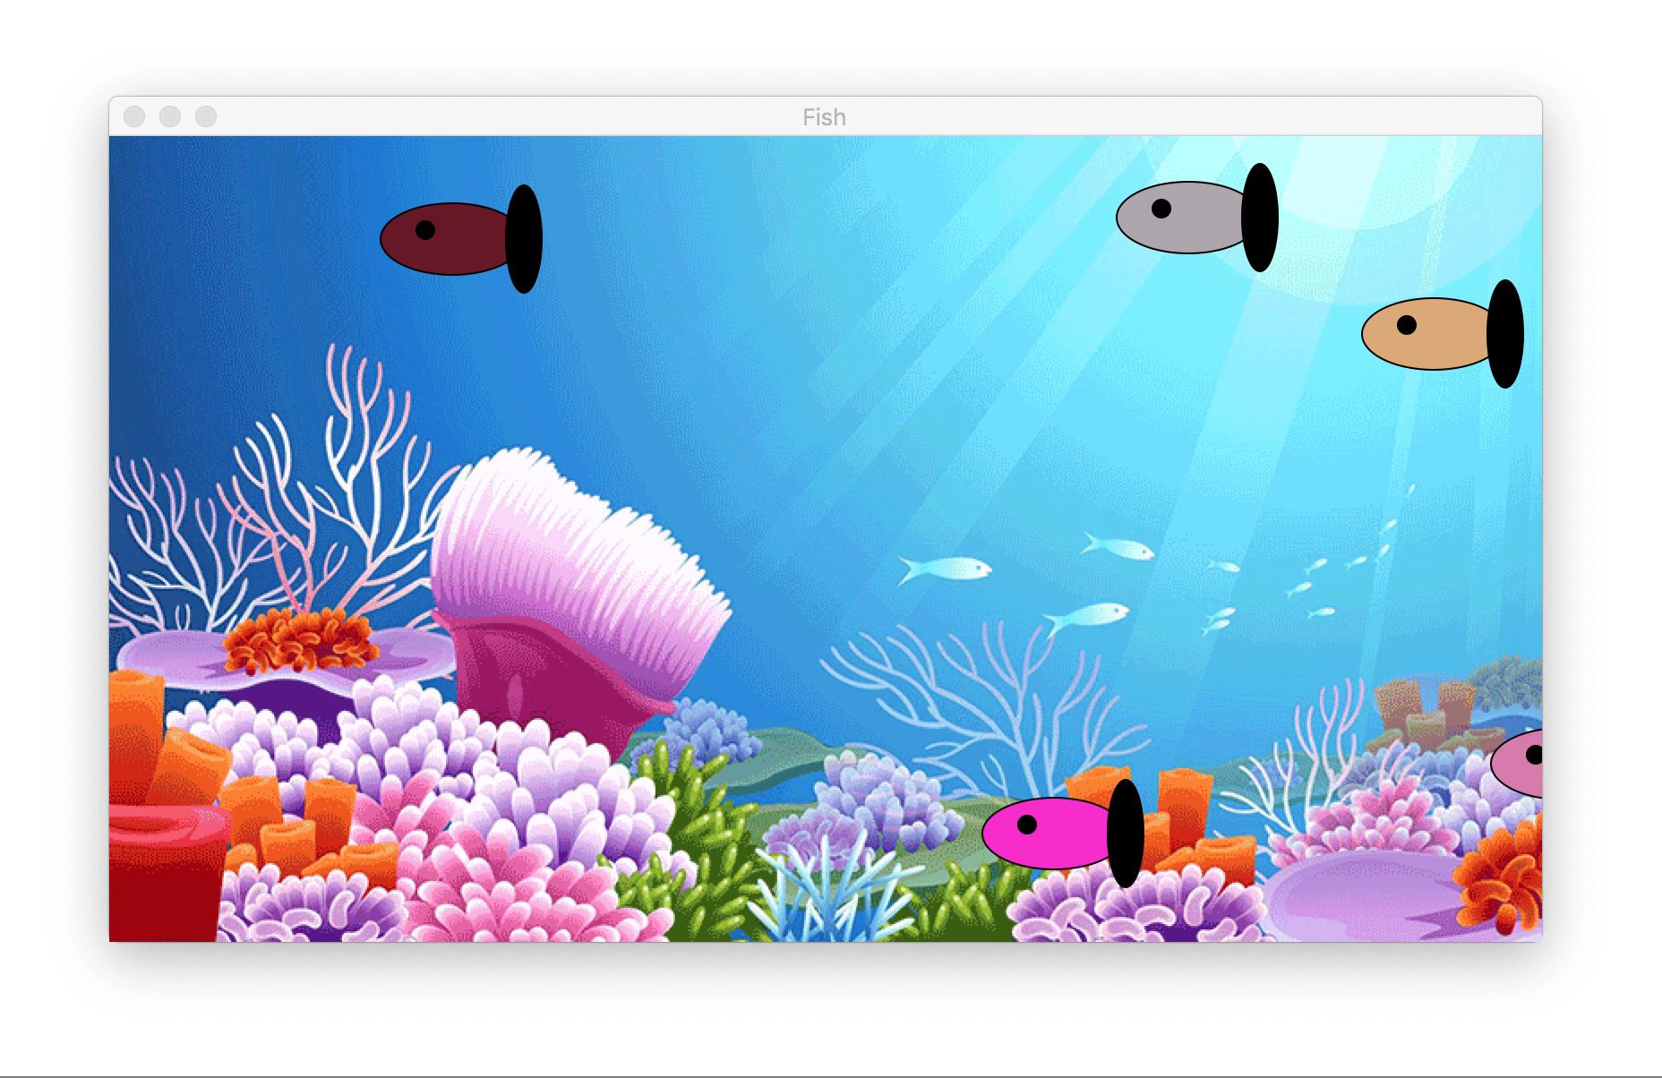
Virtual Fish Tank

Slide 4
Discussion
How do you think they built that?
What components did they need?

Slide 5

1. Draw stuff
The images we draw are composed of marks: like ink
Lines
Points
Areas

Slide 6
2. Make it move
…more about this Wednesday

Slide 7
3. Get input from the user and react
…more about this Friday

Slide 8
Hmm…
If these are the basic components of every game,
it’s probably the case that someone else
has had to build them before…

Slide 9
The graphics module*
Two kinds of objects:
stuff you draw (Graphics objects)
stuff you draw on (GraphWin objects)
Basic formula for drawing graphics:
open a graphic window (a GraphWin)
construct some Point, Line, Circle, Oval, Rectangle, Polygon, and Text objects
draw them to the window
close the window when you’re done
terminate the program
written by John Zelle to go along with his book “Python Programming: An Introduction to Computer Science” (Franklin, Beedle & Associates)
Available from: http://mcsp.wartburg.edu/zelle/python/

Slide 10
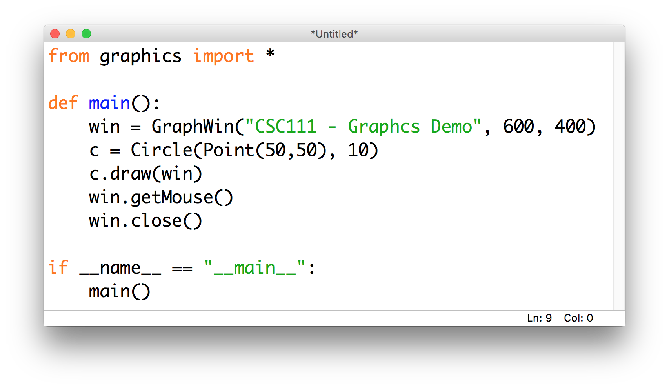
Our first graphics program

Slide 11
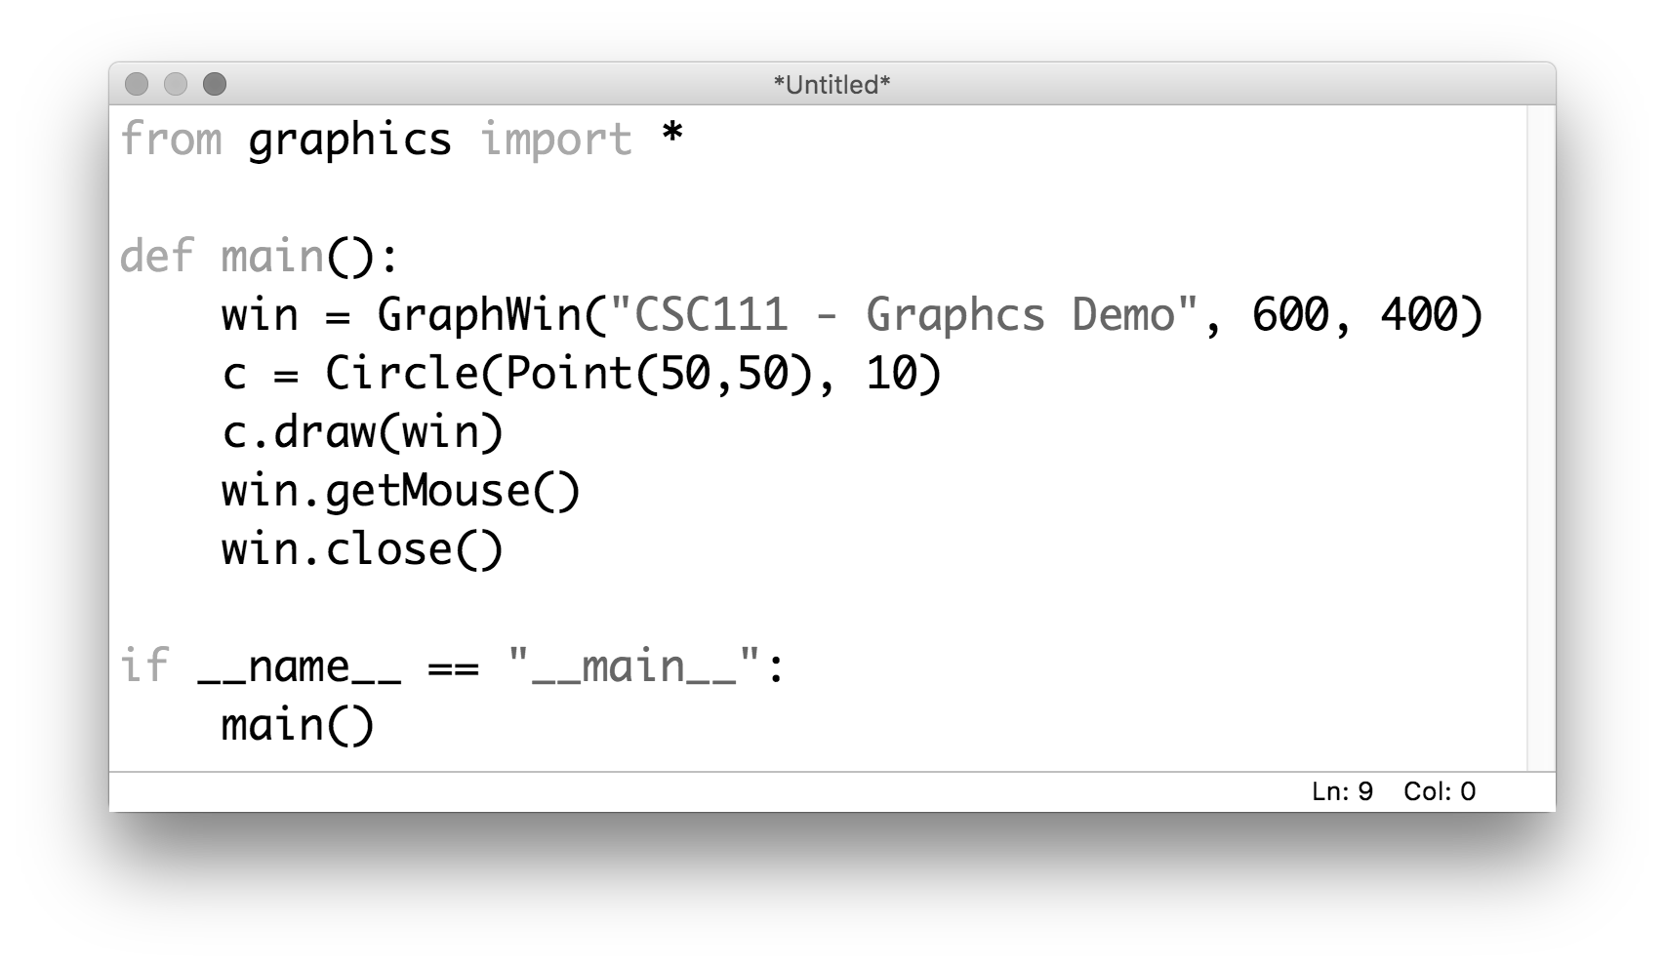
Our first graphics program
import the module
(this method means we don’t have to type
“graphics.” in front of every method)

Slide 12
Our first graphics program
build a GraphWin object
width
height

Slide 13
Our first graphics program
construct a Circle object
(centered at (50,50) with a radius of 10)

Slide 14
Our first graphics program
draw the Circle to the GraphWin

Slide 15
Our first graphics program
wait for the user to click
(so we can actually look at what we drew)

Slide 16
Our first graphics program
close the GraphWin

Slide 17
Our first graphics program

Slide 18
First “graphical primitives”

Slide 19
First “graphical primitives”

Slide 20
First “graphical primitives”

Slide 21
First “graphical primitives”

Slide 22
Filling an object with color

Slide 23
What if we want a more specific color?

Slide 24
Okay, let’s make a fish!
20px
5px
40px
60px
80px

